Slide 1

Project 1: Brain Tumor Subtyping

Slide 2

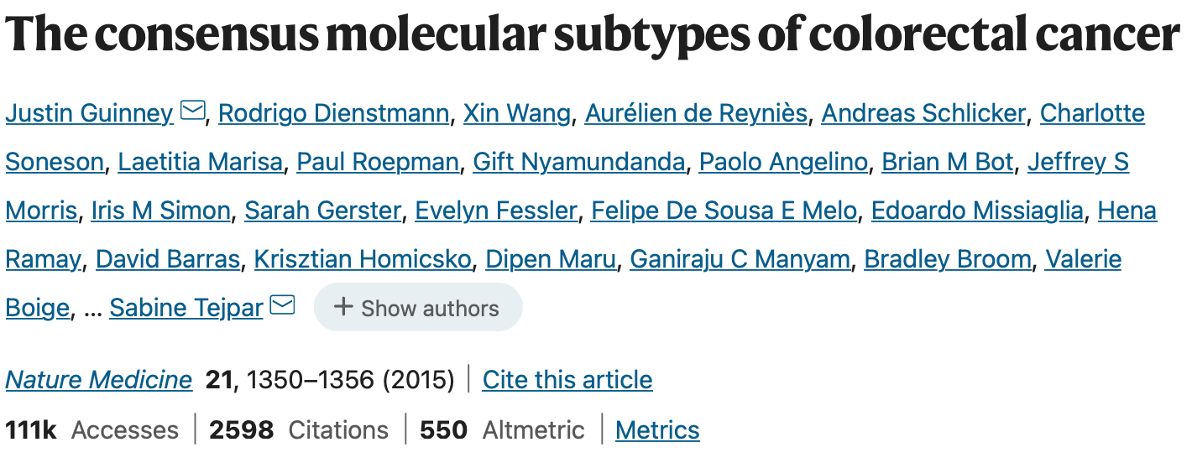

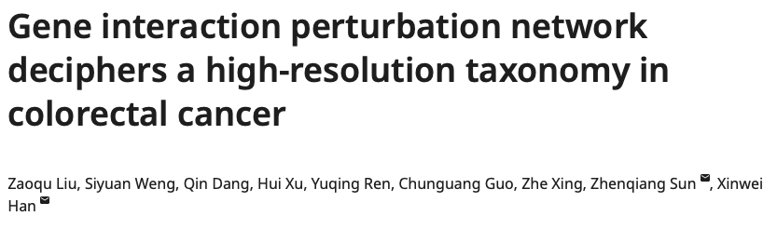
Tumor subtyping

Slide 3
The idea of subtyping
Molecular characteristics
Clinical applications
Patient-specific treatment

Slide 4


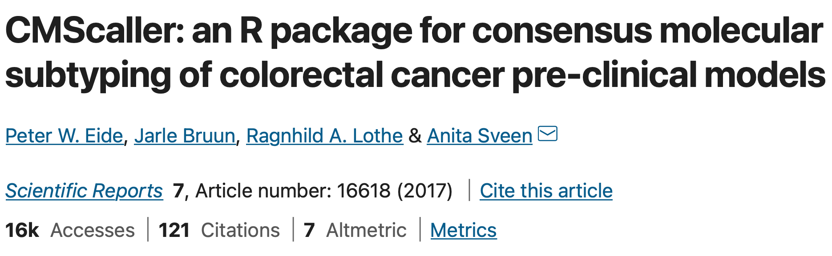
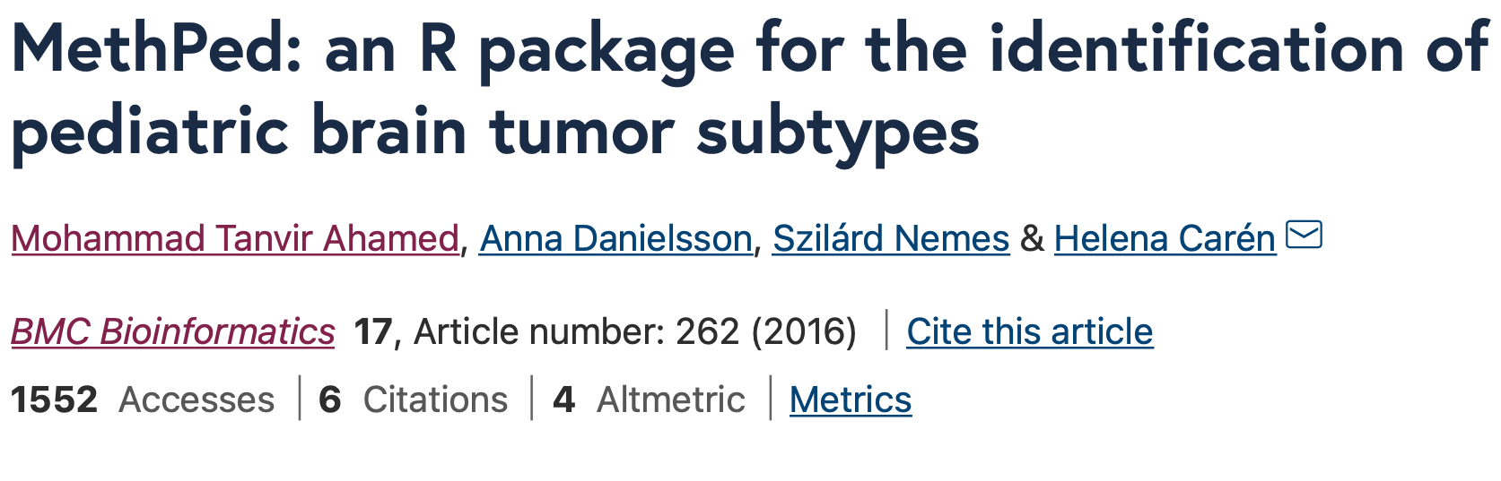

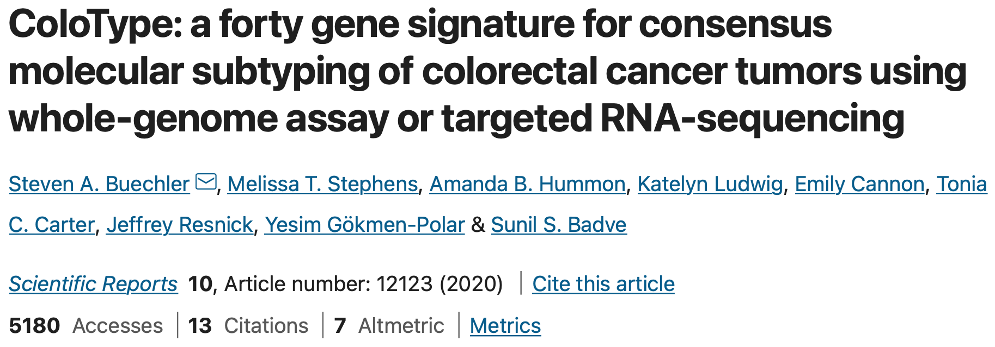
Bioinformatics and cancer

Slide 5

More than the genome
Epigenomics: DNA methylation

Slide 6
Cancer data
The Cancer Genome Atlas
Gene Expression Omnibus
UCSC Xena
…

Slide 7
Have fun!

